Slide 1
How to give a great research talk
Based in part on on material from Simon.Jones, J.Huges, J. Launchbury,
Stephanie Pfirman, Tom Carsey

Slide 2
Giving a good talk
This presentation is about how to give a good research talk
What your talk is for
What to put in it (and what not to)
How to present it

Slide 3
Why you should listen to this talk
Because many research talks are poor...
...and quite simple things can make your talks much better
Because everyone benefits from good talks
Your audience is happier
You get promoted
Because a research talk gives you access to the world’s most priceless commodity: the time and attention of other people. Don’t waste it!

Slide 4
What your talk is for
Your paper = The beef
Your talk = The sizzle, advertising the beef
Do not confuse the two

Slide 5
Which ”scale” talk are you giving?
1-3Min
5Min
10Min
20Min
30min
Job talk
Advertising to get them to look at paper.
Why+Overview of what is most important
Why,What (what more) & How
Why,What (what more) & How &How it fails
Why,What (what more) & How + Details
Who,Why,What & Why can do other things

Slide 6
The purpose of your talk…
The purpose of your talk is not:
To impress your audience with your brainpower
To tell them all you know about your topic
To present all the technical details

Slide 7
The purpose of your talk…
The purpose of your talk is:
To give your audience an intuitive feel for your idea
To make them foam at the mouth with eagerness to read your paper
To engage, excite, provoke them
To make them glad they came

Slide 8
Your audience…
The audience you might think you would like
Have read all your earlier papers
Thoroughly understand all the relevant theory of cartesian closed endomorphic bifunctors
Are all agog to hear about the latest developments in your work
Are fresh, alert, and ready for action

Slide 9
But that is probably a very small audience
And they will read they paper anyhow

Slide 10
Your actual audience…
The audience you get
Have never heard of you
Have heard of your subarea, but probably wish they hadn’t
Have just had lunch and are ready for a doze
Your mission is to
WAKE THEM UP
And make them glad you did

Slide 11

Tell a Story
Prepare your material so that it tells a story logically
Use examples, anecdotes, and significant details
Create continuity so that your slides flow smoothly
Guide the audience through your story
Your last point on one slide can anticipate the next slide
http://www.cgd.ucar.edu/cms/agu/scientific_talk.html

Slide 12
What to put in

Slide 13
What to put in
Motivation (20%)
Part of your key idea (70%)
Impact 10%

Slide 14
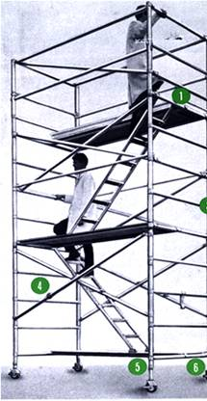
Structure
Basic rule
Say what you are going to say
1-3 main points in the Motivation
Say it
Give the talk’s key ideas
Then say what is the impact of what you said
Don’t try to build suspense and then unveil a surprise ending
http://www.safetyoffice.uwaterloo.ca/hspm/tools/images/scaffold_stair.png

Slide 15
Motivation
You have 15 seconds for they judge and 2 minutes
to engage your audience before they start to doze
They are thinking...
Why should I tune into this talk?
What is the problem?
Why is it an interesting problem?
Does this talk describe a worthwhile advance?

Slide 16
The Motivation should end with a 1-sentence story. THE BARE BONES VERSION OF THE EIGHT ESSENTIAL ELEMENTS _______________ (CHARACTER) NEEDED _________________ BECAUSE _________________ BUT _____________________ SO, _____________________ FINALLY ___________________

Slide 17
Your key idea
If the audience remembers only one thing from your talk, what should it be?
You must identify a key idea. “What I did this summer” is Not Good.
Be specific. Don’t leave your audience to figure it out what is important for themselves.
Be absolutely specific. Say “If you remember nothing else, remember this.” Or “The key idea is..”
Organize your talk around this specific goal. Ruthlessly prune material that is irrelevant to this goal.

Slide 18

Narrow, deep beats wide, shallow
No
Best
Better
Avoid shallow overviews at all costs
Cut quickly to the chase: the technical “meat”
Best is quick context, the meat, and broad impact at end

Slide 19
Your main weapon
Examples & stories are your main weapons
To motivate the work
To convey the basic intuition
To illustrate The Idea in action
To show extreme cases
To highlight shortcomings
When time is short, omit the details, not the example

Slide 20
Paper Ruberic
90 total
15 Story
30 Comparative Analsysis
20 Number and appropriate Refernces
25 Writing, style grammar.

Slide 21
What to leave out

Slide 22
Skip the “Outline of my talk” (unless >30min)
Background
The FLUGOL system
Shortcomings of FLUGOL
Overview of synthetic epimorphisms
π-reducible decidability of the pseudo-curried fragment under the Snezkovwski invariant in FLUGOL
Benchmark results
Related work
Conclusions and further work

Slide 23
No outline!
“Outline of my talk”: conveys near zero information at the start of your talk
Worse, since your audience only gives you 2 minutes before dozing, you’ve just lost them
But in long talks can put up an outline for orientation after your motivation
…and if >30min can have signposts at pause points during the talk

Slide 24
Related work
[PMW83] The seminal paper
[SPZ88] First use of epimorphisms
[PN93] Application of epimorphisms to wibblification
[BXX98] Lacks full abstraction
[XXB99] Only runs on Sparc, no integration with GUI

Slide 25
Do not present related work
But
You absolutely must know the related work; respond readily to questions
Acknowledge co-authors (title slide), and pre-cursors (as you go along)
Don’t forget acknowledgements (cite on slide), always give proper credit
Tip: Everyone in the audience has come to listen to your lecture with the secret hope of hearing their work mentioned
Praise the opposition
“X’s very interesting work does Y; I have extended it to do Z”

Slide 26
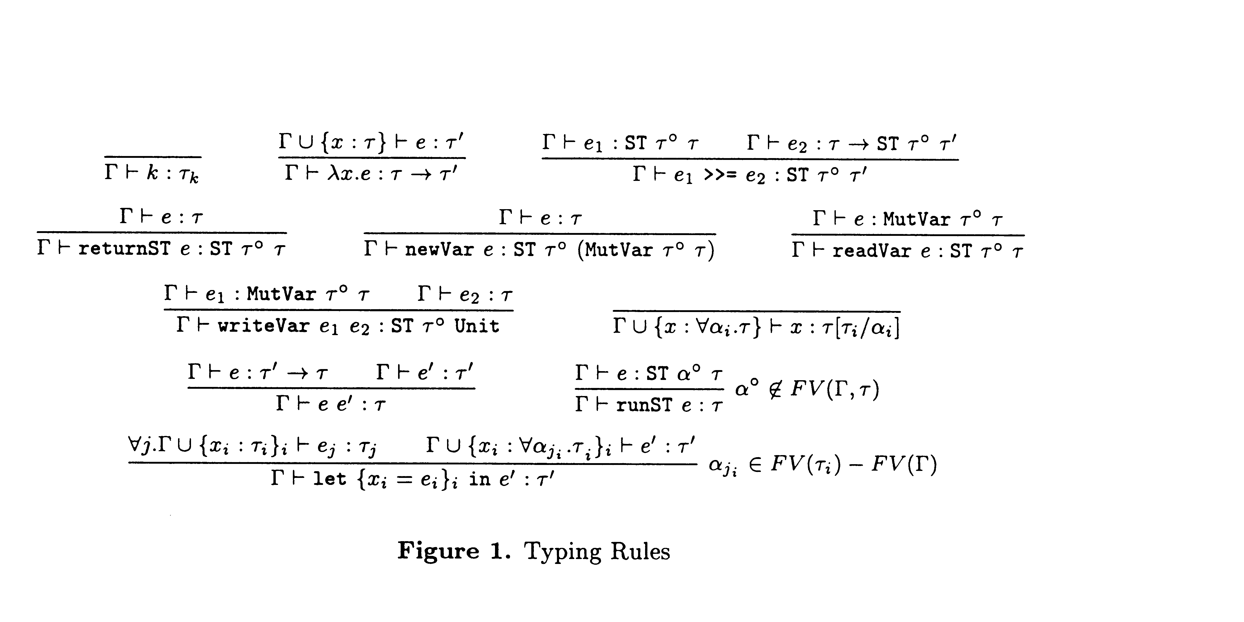
Technical detail

Slide 27
Omit technical details
Even though every line is drenched in your blood and sweat, dense clouds of notation will send your audience to sleep
Present specific aspects only; refer to the paper for the details (and poster if you have one)
By all means have backup slides to use in response to questions

Slide 28
Presenting your talk

Slide 29
How to present your talk
Your most potent weapon, by far, is your
enthusiasm

Slide 30
Enthusiasm
If you do not seem excited by your idea, why should the audience be?
It wakes ‘em up
Enthusiasm makes people dramatically more receptive
It gets you loosened up, breathing, moving around

Slide 31
Write your slides the night before
Ideas will occur to you during the conference, as you obsess on your talk during other people’s presentations. Make it fresh and update it just before you give it
But your talk absolutely must be fresh in your mind. So do review it the day before

Slide 32
Technology
Borrow a laser pointer, but avoid using it. Better to use mouse on the laptop.
Even better don’t need to point!
Consider borrowing a wireless slide changer
Test that your laptop works with the projector, in advance and just before presentation session.
Laptops break: leave a backup copy on the web; bring a backup copy on a disk or USB key

Slide 33
Do not apologize
“I didn’t have time to prepare this talk properly”
“My computer broke down, so I don’t have the results I expected”
“I don’t have time to tell you about this”
“I don’t feel qualified to address this audience”

Slide 34
The jelly effect
If you are anything like I was when I starting, you may experience apparently-severe pre-talk symptoms
Inability to breathe
Inability to stand up (legs give way)
Inability to operate brain

Slide 35
What to do about it
Deep breathing during previous talk
Script your first few sentences precisely (=> no brain required)
Use time talks/videos.
Practice, Practice (maybe with flying objects;-)
Move around a lot, use large gestures, wave your arms, stand on chairs
Go to the bathroom before the session.
You are not a wimp. Most People feels this way.

Slide 37
Being seen, being heard
DO NOT turn to the screen. Point using mouse and keep facing the audience.
Speak to someone at the back of the room, even if you have a microphone on
Make eye contact; identify a nodder, and speak to him or her (better still, more than one).
Don’t focus on a friend.
Watch audience for body-language and questions…

Slide 38
Questions
Questions are not a problem
Specifically encourage questions during your talk: pause briefly now and then, ask for questions if appropriate. If there is after session send questions there.
Be prepared to truncate your talk if you run out of time. Better to connect, and not to present all your material
Questions are a golden golden golden opportunity to connect with your audience

Slide 39
Presenting your slides
A very annoying technique
is to reveal
your points
one
by one
by one, unless…
there is a punch line

Slide 40
Presenting your slides
Use animation effects
very
very
very
very
very
very
very
sparingly

Slide 41
Finishing
Absolutely without fail, finish on time
Audiences get restive and essentially stop listening when your time is up. Continuing is very counter productive
Simply truncate and conclude
Do not say “would you like me to go on?” (it’s hard to say “no thanks”)

Slide 42
Conclusion: there is hope
The general standard is often low. You don’t have to be outstanding to stand out
You will attend 50x as many talks as you give. Watch other people’s talks intelligently, and pick up ideas for what to do and what to avoid.

Slide 43
Do it! Do it! Do it!
Good papers and talks are a fundamental part of research excellence
Invest time
Learn skills
Practice
Write a paper, and give a talk, about any idea, no matter how weedy and insignificant it may seem to you

Slide 44
Research is communication
The greatest ideas are worthless if you keep them to yourself
Your papers and talks
Crystalise your ideas
Communicate them to others
Get feedback
Build relationships
(And garner research brownie points)

Slide 45
Talk Prep Tips
1) Know your presentation tool
2) Choose aspect ratio
3) Choose right font
4) Choose colors
5) Timing

Slide 46
What aspect? Platform? Connector
Ask about ratio
Changing aspect in PPT scales things, often oddly.
Bring connectors/converters for VGA/HDMI
Test well before your talk.

Slide 47
What Font to Use
Type size should be 18 points or larger:
18 point
20 point
24 point
28 point
36 point
Max (~ ½ the age of oldest audience member, ½ the distance to a screen)
AVOID USING ALL CAPITAL LETTERS BECAUSE IT’S MUCH HARDER TO READ
* References can be in 12-14 point font

Slide 48
Color
Dark letters against a light background work
Dark letters against a light background are best for smaller rooms, especially when the lights are on for teaching. Best for any “dim” projector
http://www.fw.msu.edu/orgs/gso/documents/GSOWorkshopDocsSp2006/PresentationTipsinPowerPoint.ppt#302,5,Powerpoint basics: 1. What font to use

Slide 49
Color
Light letters against a dark background also work
Many graphics experts feel that a dark blue or black background works best for talks in a large room, best “perceived” color & image differences. Greater chance of “sleeping”
Colors on your screen are NOT how they project Test color pallets on a projector. Check again on the actual projector
http://www.fw.msu.edu/orgs/gso/documents/GSOWorkshopDocsSp2006/PresentationTipsinPowerPoint.ppt#302,5,Powerpoint basics: 1. What font to use

Slide 50
Talk Timing
The shorter the talk the more important it is you have the timing down very tight.
I recommend auto-timed slides or a video for talks < 10min, or any length if you are nervous but will NOT be interrupted with questions.
Feels awkward at first, as they will “go on without you”. You may feel everyone is starring at you, but its less noticeable than if you have very long pauses and look lost.
Good to practice with distractions. Having things tossed at you while practicing is good.
If you record a video with narration you can “practice” via listening to help know the material cold. But beware of losing energy in final talk!

Slide 51
Copyright & Talks
If for an academic venue, “Fair use” applies. Good to have reference on source (at least in notes). Ideal choose images with “reuse rights” in google search
Images & relevant Clip art can greatly improve talk. Weakly related images/art can distract but can still work.
A talk where you can connect your story and visualize it as all the pictures on every slide is way easier to remember, for you and your audience.
Finding/creating good images takes times. But its worth it.

Slide 52
Get inspired
Lots of conferences have their talks on line. Watch some with some friends and discuss what works and what does not.
Watch some (technically oriented) TED talks. (Some TedX are good, but you don’t get to TED unless you are a good speaker).

Slide 53
7 Talk Tips (From inspiring Ted Speakers)
Immerse your audience in a story.
Tell an emotional or personal story.
Create suspense
Bring characters to life.
Show. Don’t tell.
Build up to a S.T.A.R. moment.
End with a positive takeaway.

Slide 54
Duarte, Nancy. “Resonate.” Duarte. 2014.
A successful presentation creates a connection with the audience. In other words, it has to have “Something They’ll Always Remember.” The STAR moment doesn’t have to be particularly big or flashy, but it needs to be awe-inspiring. According to Duarte, it’s all about creating a “significant, sincere, and enlightening moment…that helps magnify your big idea.
1.) Memorable Dramatization
2.) Repeatable Sound Bites
3.) Evocative Visuals
4.) Emotive Storytelling
5.) Shocking Statistics

Slide 55


#5 STICKY STORIES
Think about everything you say in terms of its impact on your “story” and its stickness
Notes:
Facts and figures are forgotten.
Stories are retold.
Design a sticky story.

Slide 56
SUCCESS: STICKY STORIES
Simple
Unexpected
Concrete
Credible
Emotional
Stories
Stick!
Plan for
SUCCESS

